Slide 1
Psychology in Action
La psicología en acción

Slide 2
Hello! Let's introduce ourselves.
¡Hola! Vamos a presentarnos.

Slide 3
What’s new in science?
¿Qué hay de nuevo en la ciencia?

Slide 4
SpaceX Rocket Stage Crashes into the Moon
What happened?
A part of a SpaceX Falcon 9 rocket crashed into the Moon.
This piece was the upper stage, the section that helps push satellites or spacecraft into space
After completing its job, it drifted through space for over a year before eventually hitting the Moon
The impact was expected and posed no risk to Earth.
Why is this interesting?
The crash created a new crater and blasted lunar dust and rocks into the air
Scientists can study the crater to learn what lies beneath the Moon's surface and more about the Moon's geology and history
¿Qué pasó?
Una parte de un cohete Falcon 9 de SpaceX se estrelló contra la Luna.
Esta parte era la etapa superior, la sección que ayuda a impulsar satélites o naves espaciales hacia el espacio.
Después de completar su misión, permaneció flotando en el espacio durante más de un año antes de finalmente impactar la Luna.
El impacto era esperado y no representó ningún riesgo para la Tierra.
¿Por qué es interesante?
El impacto creó un nuevo cráter y lanzó polvo y rocas lunares al aire.
Los científicos pueden estudiar el cráter para aprender qué hay debajo de la superficie de la Luna y conocer más sobre su geología e historia.
Notes:
Think of it like dropping a rock into a sandbox. When the rock hits, it throws sand out in every direction, exposing layers that were hidden underneath. In the same way, this rocket stage created a fresh crater that scientists can study to learn what's below the Moon's surface.

Slide 5
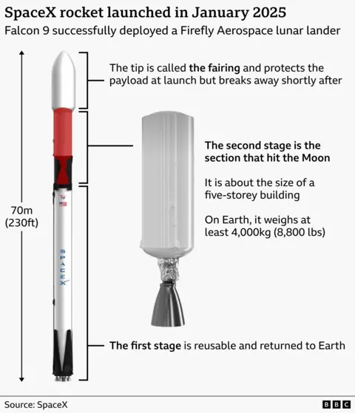
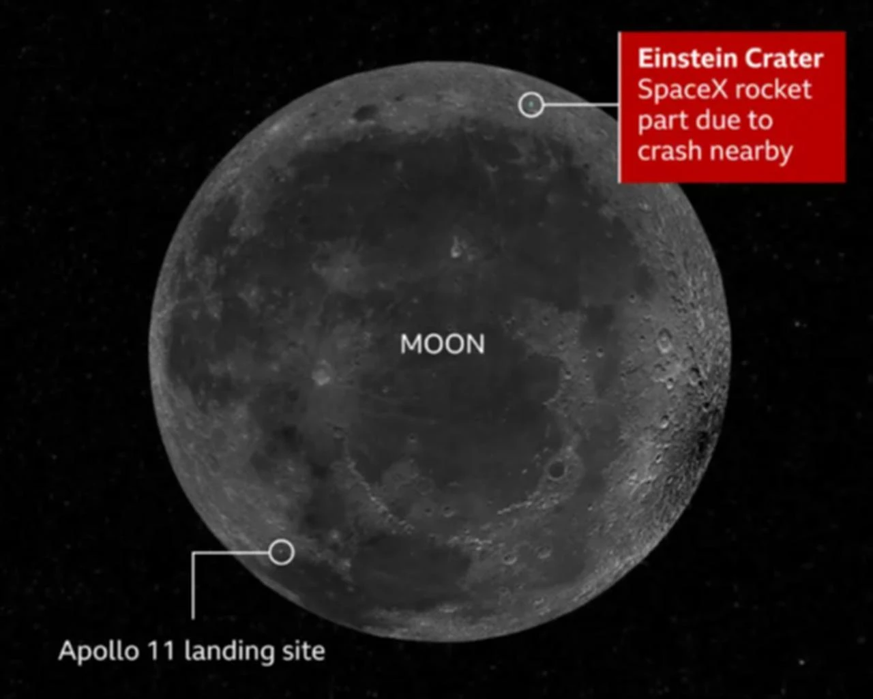
SpaceX Rocket Stage Crashes into the Moon
Notes:
Think of it like dropping a rock into a sandbox. When the rock hits, it throws sand out in every direction, exposing layers that were hidden underneath. In the same way, this rocket stage created a fresh crater that scientists can study to learn what's below the Moon's surface.

Slide 6
What is Psychology
¿Qué es la psicología?

Slide 7
Psychology Introduction
Psychology: The study of the mind, behavior, emotions, and mental processes.
Psychologist: A trained professional who studies psychology.
There are many fields of psychology.
Psicología: El estudio de la mente, el comportamiento, las emociones y los procesos mentales.
Psicólogo(a): Un profesional capacitado que estudia la psicología.
Hay muchos campos de la psicología.

Slide 8
Psychology Fields
Clinical Psychology: Focuses on studying and treating mental health problems.
Psicología clínica: Se enfoca en el estudio y tratamiento de los problemas de salud mental.

Slide 9
Psychology Fields
Clinical Psychology: Focuses on studying and treating mental health problems.
Cognitive Psychology: The study of mental processes and how people think.
Psicología clínica: Se enfoca en el estudio y tratamiento de los problemas de salud mental.
Psicología cognitiva: El estudio de los procesos mentales y de cómo las personas piensan.

Slide 10
Psychology Fields
Clinical Psychology: Focuses on studying and treating mental health problems.
Cognitive Psychology: The study of mental processes and how people think.
Developmental Psychology: Study how psychology of people changes over time.
Psicología clínica: Se enfoca en el estudio y tratamiento de los problemas de salud mental.
Psicología cognitiva: El estudio de los procesos mentales y de cómo las personas piensan.
Psicología del desarrollo: Estudia cómo la psicología de las personas cambia con el tiempo.

Slide 11
Psychology Fields
Clinical Psychology: Focuses on studying and treating mental health problems.
Cognitive Psychology: The study of mental processes and how people think.
Developmental Psychology: Study how psychology of people changes over time.
Social Psychology: Study how people’s thoughts and behavior are influenced by society.
Psicología clínica: Se enfoca en el estudio y tratamiento de los problemas de salud mental.
Psicología cognitiva: El estudio de los procesos mentales y de cómo las personas piensan.
Psicología del desarrollo: Estudia cómo la psicología de las personas cambia con el tiempo.
Psicología social: Estudia cómo los pensamientos y el comportamiento de las personas son influenciados por la sociedad.

Slide 12
Psychology Fields
Clinical Psychology: Focuses on studying and treating mental health problems.
Cognitive Psychology: The study of mental processes and how people think.
Developmental Psychology: Study how psychology of people changes over time.
Social Psychology: Study how people’s thoughts and behavior are influenced by society.
Educational Psychology: Focuses on how people learn and teaching.
There are many other fields and subfields of psychology.
Psicología clínica: Se enfoca en el estudio y tratamiento de los problemas de salud mental.
Psicología cognitiva: El estudio de los procesos mentales y de cómo las personas piensan.
Psicología del desarrollo: Estudia cómo la psicología de las personas cambia con el tiempo.
Psicología social: Estudia cómo los pensamientos y el comportamiento de las personas son influenciados por la sociedad.
Psicología educativa: Se enfoca en cómo aprenden las personas y en la enseñanza.
Hay muchos otros campos y subcampos de la psicología.

Slide 13

Psychology Today

Slide 14
Trends in Current Psychology Research
Tendencias en la investigación psicológica actual
Neuroscience & Brain Imaging: Using fMRI, EEG, and other brain scans to study thoughts, emotions, and behavior.
Neurociencia y Neuroimagen: Uso de fMRI, EEG y otros escaneos cerebrales para estudiar pensamientos, emociones y comportamiento.

Slide 15
Trends in Current Psychology Research
Tendencias en la investigación psicológica actual
Neuroscience & Brain Imaging: Using fMRI, EEG, and other brain scans to study thoughts, emotions, and behavior.
Genetics & Epigenetics: Studying how genes and environment interact to influence mental health and behavior.
Neurociencia y Neuroimagen: Uso de fMRI, EEG y otros escaneos cerebrales para estudiar pensamientos, emociones y comportamiento.
Genética y Epigenética: Estudio de cómo los genes y el ambiente interactúan para influir en la salud mental y el comportamiento.

Slide 16
Trends in Current Psychology Research
Tendencias en la investigación psicológica actual
Neuroscience & Brain Imaging: Using fMRI, EEG, and other brain scans to study thoughts, emotions, and behavior.
Genetics & Epigenetics: Studying how genes and environment interact to influence mental health and behavior.
Cross-Cultural Psychology: Researching how culture affects cognition, emotion, and social behavior.
Neurociencia y Neuroimagen: Uso de fMRI, EEG y otros escaneos cerebrales para estudiar pensamientos, emociones y comportamiento.
Genética y Epigenética: Estudio de cómo los genes y el ambiente interactúan para influir en la salud mental y el comportamiento.
Psicología transcultural: Investigación sobre cómo la cultura afecta la cognición, las emociones y el comportamiento social.

Slide 17
Trends in Current Psychology Research
Tendencias en la investigación psicológica actual
Neuroscience & Brain Imaging: Using fMRI, EEG, and other brain scans to study thoughts, emotions, and behavior.
Genetics & Epigenetics: Studying how genes and environment interact to influence mental health and behavior.
Cross-Cultural Psychology: Researching how culture affects cognition, emotion, and social behavior.
Clinical & Translational Research: Developing new treatments for mental health disorders and testing them in real-world settings.
Neurociencia y Neuroimagen: Uso de fMRI, EEG y otros escaneos cerebrales para estudiar pensamientos, emociones y comportamiento.
Genética y Epigenética: Estudio de cómo los genes y el ambiente interactúan para influir en la salud mental y el comportamiento.
Psicología transcultural: Investigación sobre cómo la cultura afecta la cognición, las emociones y el comportamiento social.
Investigación clínica y traslacional: Desarrollo de nuevos tratamientos para trastornos de salud mental y su prueba en entornos del mundo real.

Slide 18
Psychology Careers
Carreras en psicología
Psychiatric Technician/Mental Health Technician: Work in hospitals, clinics, or residential facilities assisting people with mental health challenges.
Técnico psiquiátrico/Técnico en salud mental

Slide 19
Psychology Careers
Carreras en psicología
Psychiatric Technician/Mental Health Technician: Work in hospitals, clinics, or residential facilities assisting people with mental health challenges.
Técnico psiquiátrico/Técnico en salud mental
Substance Abuse Counselor/Addiction Support Worker: Help people recover from addiction through counseling, support groups, or rehab programs.
Consejero de abuso de sustancias/Trabajador de apoyo en adicciones

Slide 20
Psychology Careers
Carreras en psicología
Psychiatric Technician/Mental Health Technician: Work in hospitals, clinics, or residential facilities assisting people with mental health challenges.
Técnico psiquiátrico/Técnico en salud mental
Substance Abuse Counselor/Addiction Support Worker: Help people recover from addiction through counseling, support groups, or rehab programs.
Consejero de abuso de sustancias/Trabajador de apoyo en adicciones
Behavioral Health Aide/Peer Support Specialist: Use personal experience to support others in recovery.
Asistente de salud conductual/Especialista en apoyo entre pares

Slide 21
Psychology Careers
Carreras en psicología
Case Manager/Social Services Assistant: Help clients navigate social services, housing, and healthcare.
Administrador de casos/Asistente de servicios sociales
Psychiatric Technician/Mental Health Technician: Work in hospitals, clinics, or residential facilities assisting people with mental health challenges.
Técnico psiquiátrico/Técnico en salud mental
Substance Abuse Counselor/Addiction Support Worker: Help people recover from addiction through counseling, support groups, or rehab programs.
Consejero de abuso de sustancias/Trabajador de apoyo en adicciones
Behavioral Health Aide/Peer Support Specialist: Use personal experience to support others in recovery.
Asistente de salud conductual/Especialista en apoyo entre pares

Slide 22
Psychology Careers
Carreras en psicología
Case Manager/Social Services Assistant: Help clients navigate social services, housing, and healthcare.
Administrador de casos/Asistente de servicios sociales
Residential Counselor/Group Home Staff: Work in halfway houses, shelters, or group homes supporting residents’ daily routines and personal growth.
Consejero residencial / Personal de hogar grupal
Psychiatric Technician/Mental Health Technician: Work in hospitals, clinics, or residential facilities assisting people with mental health challenges.
Técnico psiquiátrico/Técnico en salud mental
Substance Abuse Counselor/Addiction Support Worker: Help people recover from addiction through counseling, support groups, or rehab programs.
Consejero de abuso de sustancias/Trabajador de apoyo en adicciones
Behavioral Health Aide/Peer Support Specialist: Use personal experience to support others in recovery.
Asistente de salud conductual/Especialista en apoyo entre pares

Slide 23
Psychology Careers
Carreras en psicología
Case Manager/Social Services Assistant: Help clients navigate social services, housing, and healthcare.
Administrador de casos/Asistente de servicios sociales
Residential Counselor/Group Home Staff: Work in halfway houses, shelters, or group homes supporting residents’ daily routines and personal growth.
Consejero residencial / Personal de hogar grupal
Rehabilitation Specialist: Assist people with mental health or substance abuse issues in returning to work or school.
Especialista en rehabilitación
Psychiatric Technician/Mental Health Technician: Work in hospitals, clinics, or residential facilities assisting people with mental health challenges.
Técnico psiquiátrico/Técnico en salud mental
Substance Abuse Counselor/Addiction Support Worker: Help people recover from addiction through counseling, support groups, or rehab programs.
Consejero de abuso de sustancias/Trabajador de apoyo en adicciones
Behavioral Health Aide/Peer Support Specialist: Use personal experience to support others in recovery.
Asistente de salud conductual/Especialista en apoyo entre pares

Slide 24
Psychology Careers
Carreras en psicología
Case Manager/Social Services Assistant: Help clients navigate social services, housing, and healthcare.
Administrador de casos/Asistente de servicios sociales
Residential Counselor/Group Home Staff: Work in halfway houses, shelters, or group homes supporting residents’ daily routines and personal growth.
Consejero residencial / Personal de hogar grupal
Rehabilitation Specialist: Assist people with mental health or substance abuse issues in returning to work or school.
Especialista en rehabilitación
Administrative Roles in Mental Health Organizations: Scheduling, intake, or office work at clinics and treatment centers.
Roles administrativos en salud mental
Psychiatric Technician/Mental Health Technician: Work in hospitals, clinics, or residential facilities assisting people with mental health challenges.
Técnico psiquiátrico/Técnico en salud mental
Substance Abuse Counselor/Addiction Support Worker: Help people recover from addiction through counseling, support groups, or rehab programs.
Consejero de abuso de sustancias/Trabajador de apoyo en adicciones
Behavioral Health Aide/Peer Support Specialist: Use personal experience to support others in recovery.
Asistente de salud conductual/Especialista en apoyo entre pares

Slide 25
Impactful Experiments

Slide 26
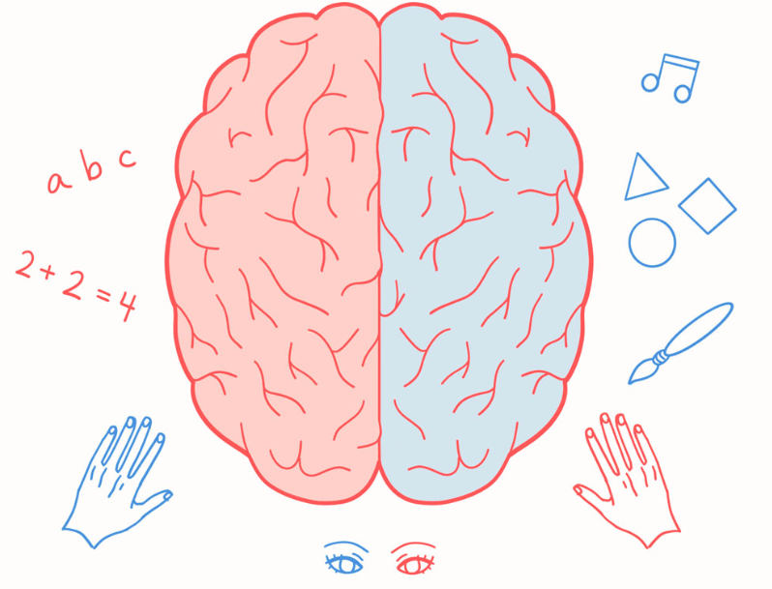
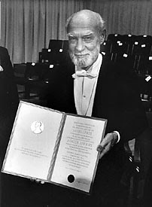
Roger Sperry
Studied people whose right and left hemispheres were surgically disconnected
Estudió a personas cuyos hemisferios derecho e izquierdo estaban quirúrgicamente desconectados
Discovered that people could only understand language presented to their left brain
Descubrió que las personas solo podían comprender el lenguaje que se les presentaba al hemisferio izquierdo
When an image was presented to the person's right brain, the subject would say “I didn’t see anything”, but then they could draw the image
Cuando se le presentaba una imagen al hemisferio derecho de la persona, el sujeto decía “No vi nada”, pero luego podía dibujar la imagen.
Notes:
Students may have heard that the left and right parts of our brain have different functions. Namely, the left brain is responsible for language and logic, while the right brain is responsible for creativity.
Sperry showed that split brain subjects demonstrate “two minds”
This has led to lots of research on consciousness, but science has still not agreed on anything

Slide 27
Activity: Stroop Effect
Actividad: Efecto Stroop
Notes:
We will show a list of colors, English on the left and Spanish on the right. In your head, say the color that each word in the list is printed in.
Could be fun if someone wants to volunteer

Slide 28
Green
Black Yellow
Red
Blue
Orange
Purple
Verde
Negro Amarillo
Rojo
Azul
Naranja
Morado
Notes:
Now we will rearrange the list. Do this in your head again.

Slide 29
Purple
Yellow
Black
Green
Red
Orange
Blue
Morado
Amarillo
Negro
Verde
Rojo
Naranja
Azul
Notes:
For example, when the name of a color is printed in a different color ink, it takes longer and is more error-prone to say the color of the ink than to read the word.
This demonstrates the conflict between automatic processing (reading) and controlled processing (naming the ink color).
It highlights how automatic thoughts can interfere with tasks requiring attention and control.

Slide 30
What is consciousness?
¿Qué es la conciencia?
How did the color task feel?
¿Cómo se sintió la tarea de colores?
Notes:
Ask the class.
There is no unanimously agreed upon definition in science, but one popular definition is that consciousness is the unification of all the functions of the brain (emotions, motivations, sensation, imagination, memories, etc) into a complete experience.
How does the stroop task (the feeling of having two conflicting thought streams) feel different from normal experience?

Slide 31
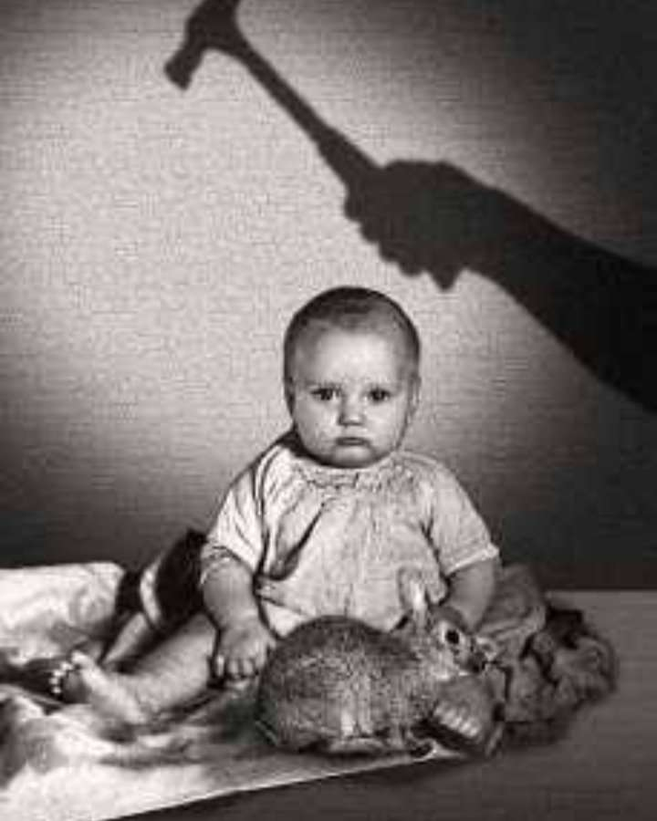
Little Albert (1920)
Methods: Albert was shown several animals: a dog, monkey, bunny, and rat. Initially, he showed no fear of any of them. Each time Albert touched the white rat, the experimenters struck a hammer against a metal bar, creating a loud, frightening noise.
Métodos: A Albert se le mostraron varios animales: un perro, un mono, un conejo y una rata. Al principio, no mostraba miedo de ninguno de ellos. Cada vez que Albert tocaba la rata blanca, los experimentadores golpeaban un martillo contra una barra de metal, creando un ruido fuerte y aterrador.
Notes:
Psychologists at Johns Hopkins ran an experiment on an orphaned baby to try to give him a phobia.

Slide 32
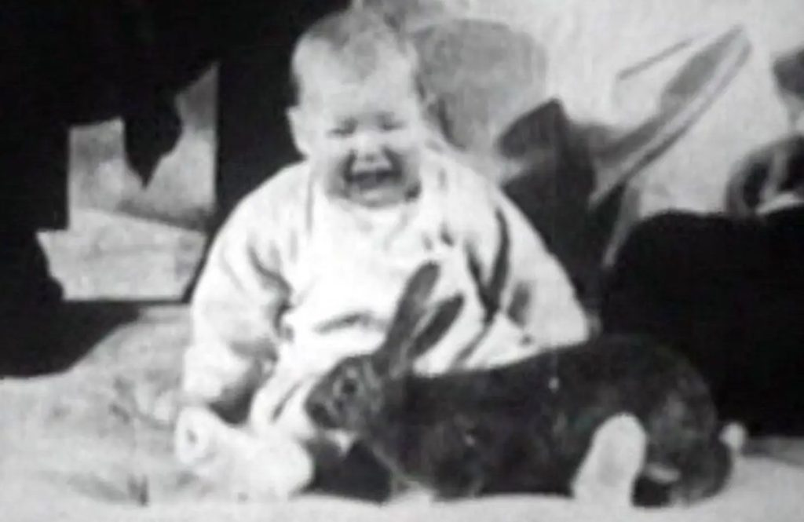
Results: After a few repetitions, Albert began to cry and show fear whenever he saw the rat, even without the loud noise.
Resultados: Después de algunas repeticiones, Albert comenzó a llorar y mostrar miedo cada vez que veía la rata, incluso sin el ruido fuerte.
Takeaway:
Classical conditioning: Little Albert learned to fear the rat because the rat was repeatedly paired with the loud noise.
Generalization: Albert began to show fear of other similar objects, like a rabbit or a dog, not just the rat.
Conclusión:
Condicionamiento clásico: Little Albert aprendió a tener miedo de la rata porque esta se emparejaba repetidamente con el ruido fuerte.
Generalización: Albert comenzó a mostrar miedo de otros objetos similares, como un conejo o un perro, no solo de la rata.

Slide 33
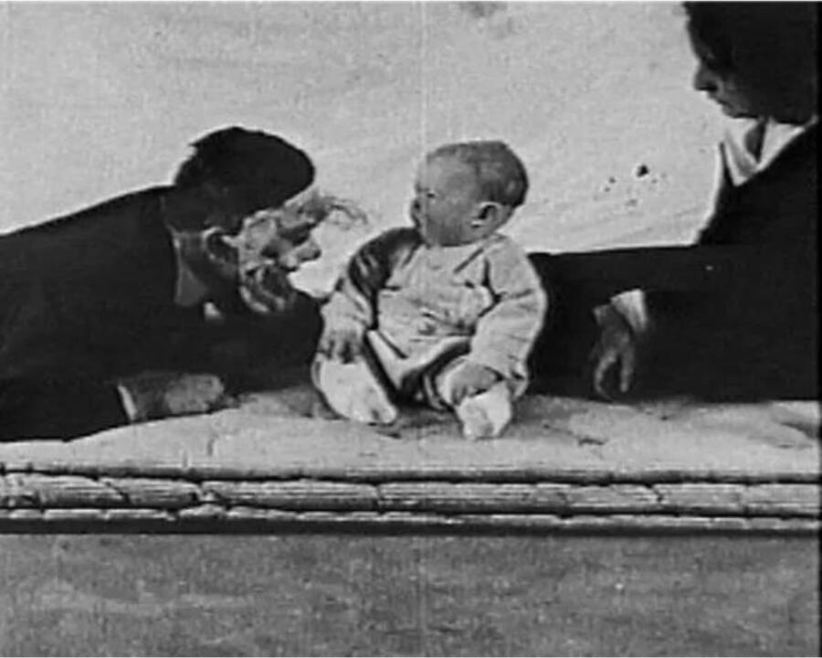
Shown here is psychologist John Watson wearing a bunny mask and little Albert’s fearful response
Aquí se muestra al psicólogo John Watson con una máscara de conejo y la reacción de miedo del pequeño Albert.

Slide 34
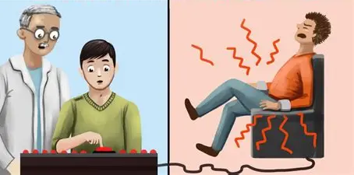
Milgram Obedience Experiment (1961)
Experimento de obediencia de Milgram
Methods: Participants were told they were part of a learning experiment. Each participant was the “teacher” and had to give electric shocks to a “learner” whenever the learner answered a question wrong.
The shocks were actually fake, and the learner was an actor. The shocks started low and got stronger with each mistake.
Métodos: A los participantes se les dijo que formaban parte de un experimento sobre aprendizaje. Cada participante era el “maestro” y debía dar descargas eléctricas al “aprendiz” cada vez que este respondiera mal a una pregunta.
Las descargas en realidad eran falsas, y el aprendiz era un actor. Las descargas comenzaban bajas y aumentaban de intensidad con cada error.
Notes:
Psychologists at Yale recruited participants and told them they were assisting with an experiment to test how punishment affects learning. The experimenters instructed the participants to administer shocks when someone answered a question incorrectly. In reality, those answering the questions and receiving shocks were actors, and the real experiment was testing how far participants would go in inflicting pain on others because an authoritative figure instructed them to do so.

Slide 35
Results: Many participants kept giving shocks, even when the learner pretended to be in pain. About 65% of participants went all the way and gave the highest level of shocks, even though they felt uncomfortable.
Resultados: Muchos participantes continuaron aplicando descargas, incluso cuando el aprendiz simulaba dolor. Aproximadamente el 65% de los participantes llegó hasta el final y aplicó el nivel más alto de descargas, aunque se sintieran incómodos.
Takeaway: The experiment shows that people tend to obey authority, even when it goes against their own morals. It helps us understand how social influence and authority can affect human behavior.
Conclusión: El experimento muestra que las personas tienden a obedecer a la autoridad, incluso cuando eso va en contra de su propia moral. Esto ayuda a entender cómo la influencia social y la autoridad pueden afectar el comportamiento humano

Slide 36
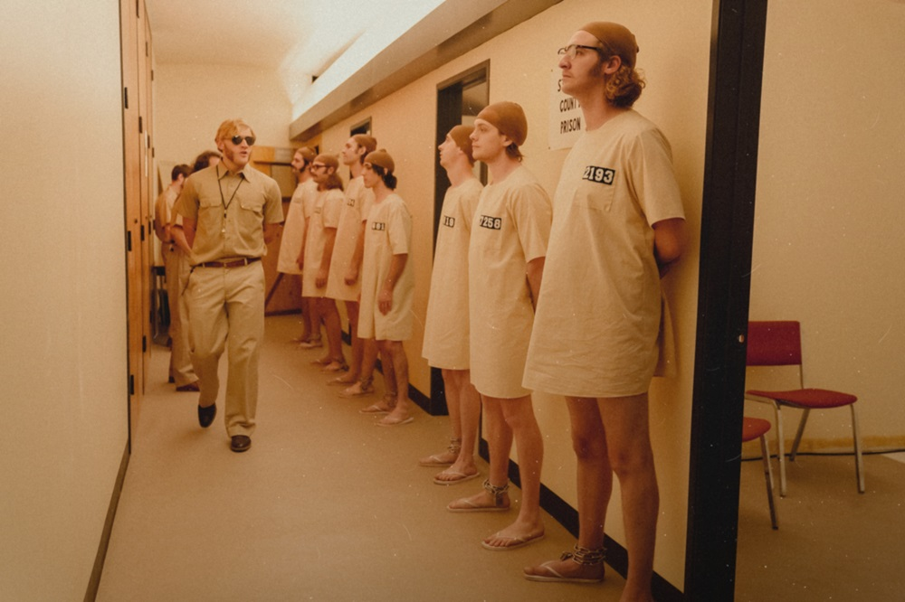
Stanford Prison Experiment (1971)
Methods:
Participants: 24 male college students
Procedure: Students were randomly assigned to be guards or prisoners. They were told to act according to their roles, with very little other instruction.
Métodos: Participantes: 24 estudiantes universitarios varones. Procedimiento: Los estudiantes fueron asignados al azar para ser guardias o prisioneros. Se les dijo que actuaran según su rol, con muy pocas instrucciones adicionales.

Slide 37
Results: Within 2 days, guards were removing mattresses, stripping prisoners, and spraying them with fire extinguishers. Prisoners began refusing orders and insulting guards.
The situation escalated quickly, showing intense changes in behavior due to assigned roles.
Resultados: En 2 días, los guardias comenzaron a quitar colchones, desnudar a los prisioneros y rociarlos con extintores. Los prisioneros empezaron a rechazar órdenes e insultar a los guardias. La situación escaló rápidamente, mostrando cambios intensos en el comportamiento debido a los roles asignados.
Takeaway: The experiment shows that ordinary people can behave cruelly or submissively when placed in certain roles and social situations, highlighting the power of environment and authority on behavior.
Conclusión: El experimento muestra que personas comunes pueden comportarse de manera cruel o sumisa cuando se les asignan ciertos roles y se encuentran en determinadas situaciones sociales, lo que resalta el poder del entorno y la autoridad sobre el comportamiento.
Notes:
Researchers at stanford recruited 24 male students and randomly split them into guards and prisoners to study the effect of roles, rules, and group identity on behavior. They were told to act in the role they were assigned, with little other instruction
Within 2 days, guards were removing mattresses from cells, stripping prisoners of their clothes, and sprayed them with fire extinguishers. Prisoners were refusing guard orders and insulting guards.
The experiment was shut down after 6 days

Slide 38
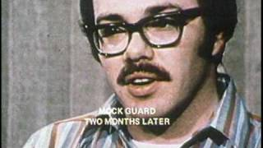
Notes:
The video shows a post-experimental interview of one of the students set to be a “guard”
It shows the power of social roles, authority, and situational pressures on behavior — people may act in ways they never imagined outside that context.

Slide 39
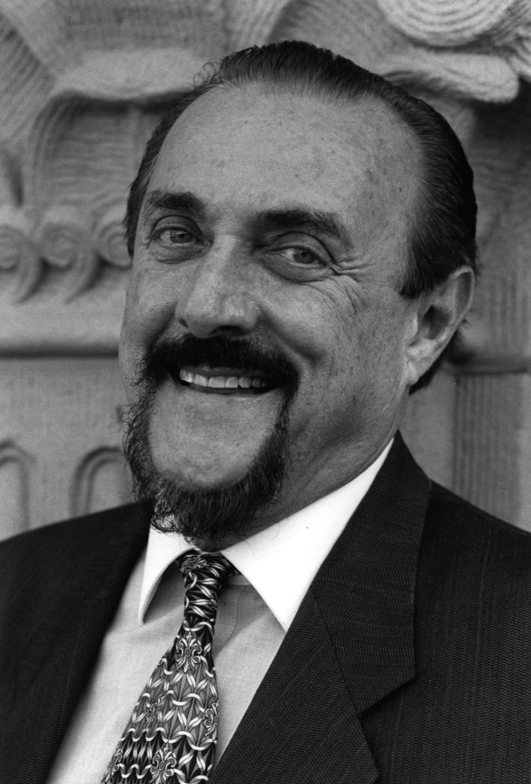
Important context
This experiment was led by a psychologist named Philip Zimbardo
He only stopped the experiment after his TA, Christina Maslach, convinced him
Zimbardo was cheating on his wife with Maslach
He and Maslach married soon after the end of the experiment
Este experimento fue dirigido por un psicólogo llamado Philip Zimbardo.
Solo detuvo el experimento después de que su asistente, Christina Maslach, lo convenciera de hacerlo.
Zimbardo le era infiel a su esposa con Maslach.
Él y Maslach se casaron poco después de finalizar el experimento.

Slide 40
Ethics
Ética
What are the ethical issues with these studies?
¿Cuáles son los problemas éticos de estos estudios?
Little Albert
Milgram Obedience
Stanford Prison
Notes:
Albert: Caused fear and distress to a baby. No consent could be given by the participant. No debriefing or attempt to remove fear afterward.
Milgram: Caused severe stress and anxiety to participants. Participants thought they were harming someone. Deception was used about the true nature of the shocks.
Stanford Prison: Participants suffered emotional and psychological harm. No clear limits on harmful behavior from guards. Deception about the roles and situation. Experiment had to be stopped early due to extreme distress.
To what extent can you bend the rules in the pursuit of knowledge? Ethics vs. results

Slide 41
Ethics is an ongoing debate
Ética
Is it ethical to use people’s social media posts for psychological research without consent?
Is it ethical to withhold a potentially effective therapy from a control group, especially for severe conditions like suicidality or PTSD?
Should study participants be paid more depending on socioeconomic status or minority group membership?
Notes:
Albert: Caused fear and distress to a baby. No consent could be given by the participant. No debriefing or attempt to remove fear afterward.
Milgram: Caused severe stress and anxiety to participants. Participants thought they were harming someone. Deception was used about the true nature of the shocks.
Stanford Prison: Participants suffered emotional and psychological harm. No clear limits on harmful behavior from guards. Deception about the roles and situation. Experiment had to be stopped early due to extreme distress.
To what extent can you bend the rules in the pursuit of knowledge? Ethics vs. results

Slide 42
Ethical Differences Today
Informed Consent – Participants must know what they are agreeing to and voluntarily participate.
Consentimiento informado – Los participantes deben saber en qué se están involucrando y participar voluntariamente.
Right to Withdraw – Participants can leave the study at any time without penalty.
Derecho a retirarse – Los participantes pueden abandonar el estudio en cualquier momento sin consecuencias.
Minimizing Harm – Researchers must avoid physical or psychological harm whenever possible.
Minimizar daños – Los investigadores deben evitar daños físicos o psicológicos siempre que sea posible.
Debriefing – Participants must be fully informed after the study, including any deception used.
Explicación posterior – Los participantes deben ser informados completamente después del estudio, incluyendo cualquier engaño usado.
Review Boards – Studies must be approved by an Institutional Review Board (IRB) to ensure ethical standards are met.
Comités de revisión – Los estudios deben ser aprobados por un Comité de Revisión Institucional para garantizar que cumplan normas éticas.
Confidentiality – Participants’ identities and data must be protected.
Confidencialidad – Las identidades y datos de los participantes deben protegerse.
Notes:
Basically, participants’ safety, rights, and well-being are now the top priority, unlike in early studies like Little Albert, Milgram, or Stanford Prison.

Slide 43

How does psychology get done?

Slide 44
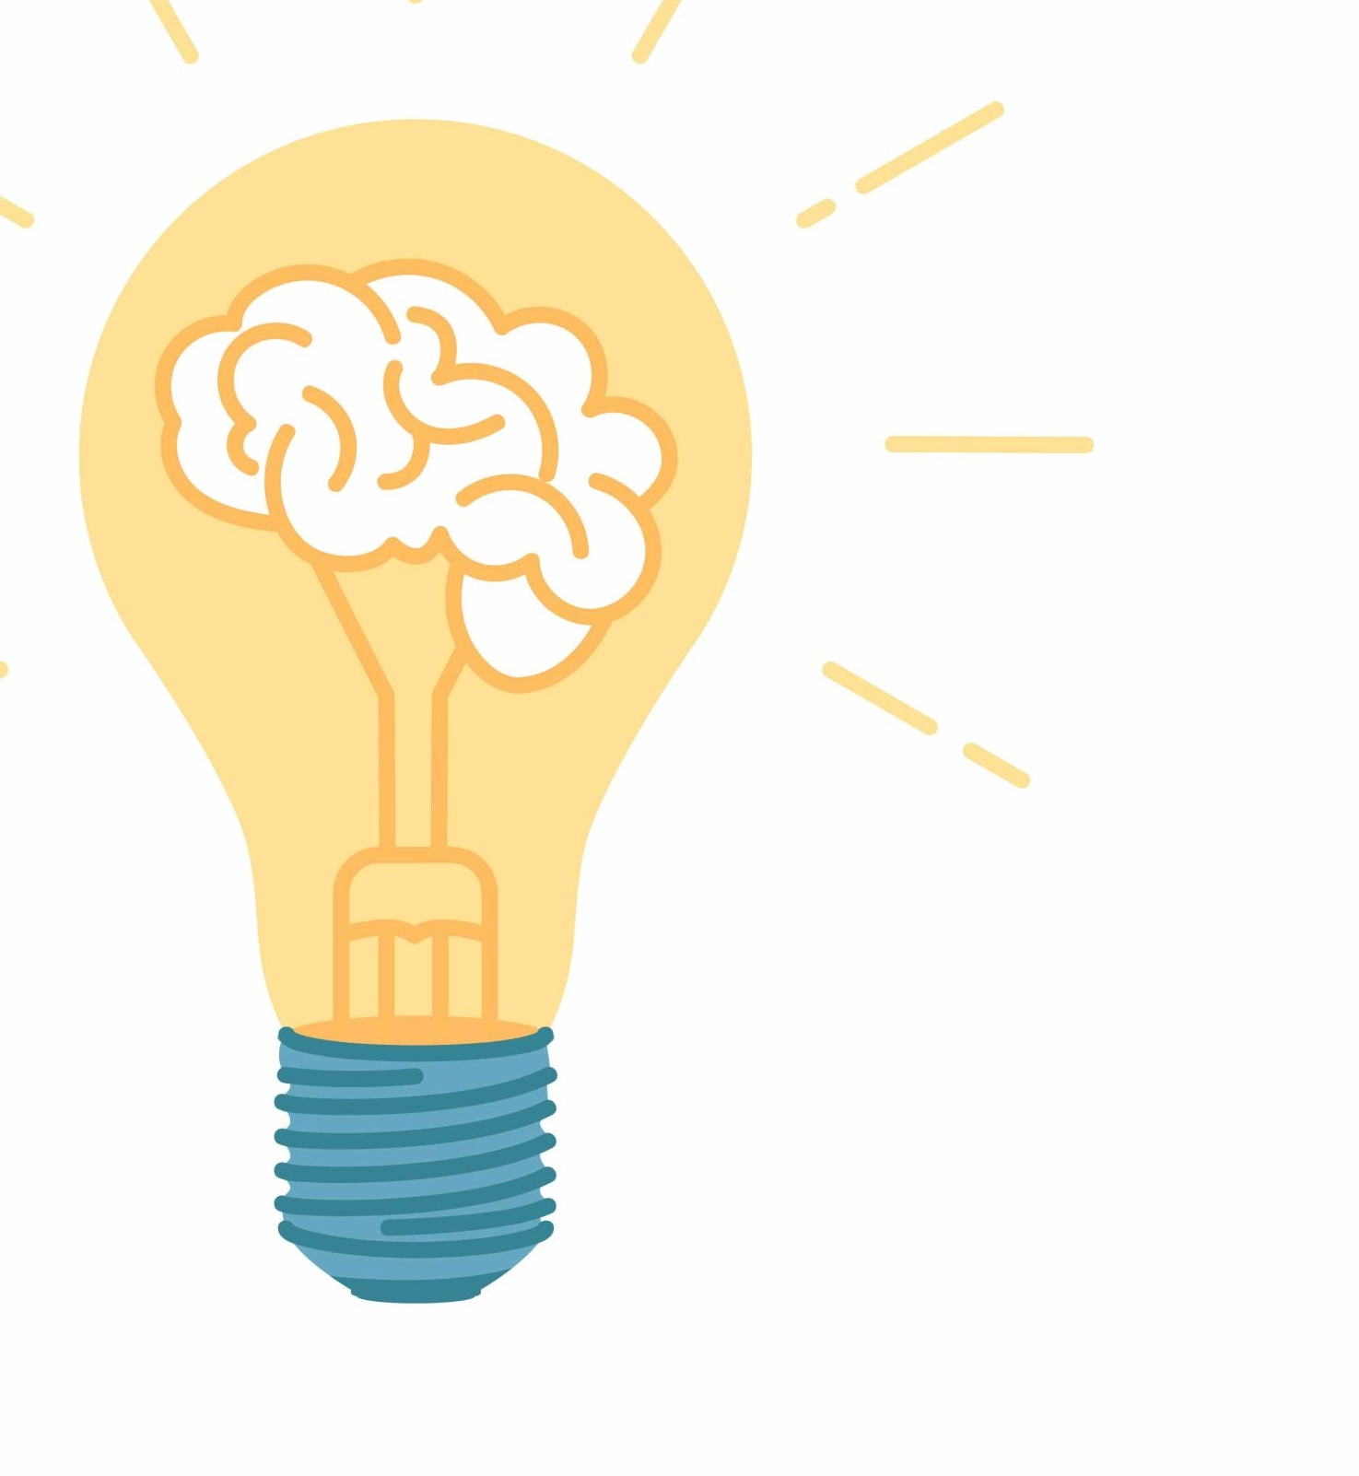
Parts of a controlled experiment:
Partes de un experimento controlado:
Hypothesis (Hipótesis)
Independent variable (Variable independiente)
Dependent variable (Variable dependiente)
Confounding variables (Variables de confusión)
Control group (Grupo de control)
Notes:
Controlled experiments are how we make scientific discoveries
Hypothesis is
Independent variable is
Dependent variable is
Confounding variables are
Control group is

Slide 45
Define the variables: independent, dependent, confounding
Define las variables: independiente, dependiente y de confusión
A public health researcher wants to determine whether daily coffee consumption affects resting heart rate in adults. To test this, the researcher recruits 100 adults between the ages of 25 and 50. For two weeks, participants are assigned to one of two groups:
Group A drinks two cups of coffee per day
Group B drinks no coffee
At the end of the two-week period, each participant’s resting heart rate is measured in the morning. The researcher then compares the average resting heart rate between the two groups to see whether coffee consumption has an effect.
Un investigador de salud pública quiere determinar si el consumo diario de café afecta la frecuencia cardíaca en reposo en adultos. Para probar esto, el investigador recluta a 100 adultos entre 25 y 50 años. Durante dos semanas, los participantes se asignan a uno de dos grupos:
Grupo A: bebe dos tazas de café al día, Grupo B: no bebe café
Al final del período de dos semanas, se mide la frecuencia cardíaca en reposo de cada participante por la mañana. Luego, el investigador compara la frecuencia cardíaca en reposo promedio entre los dos grupos para determinar si el consumo de café tiene algún efecto.
Notes:
Dependent: resting heart rate
Independent: amount of coffee consumed (2 cups vs. none)
Possible confounding:
*Baseline caffeine tolerance
*Exercise habits
*Stress levels *Sleep quality
*Diet
*Nicotine use
*Medications
*Hydration
Possible questions:
Did they use a control group? Yes- no coffee
How would you change or add to this study?

Slide 46
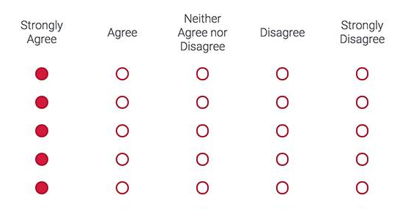
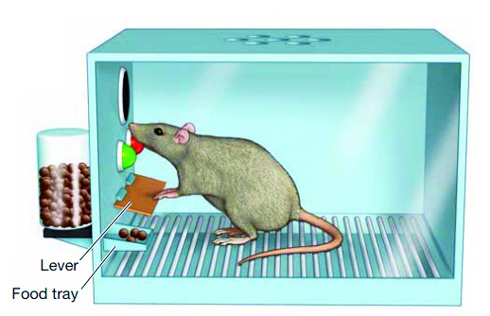
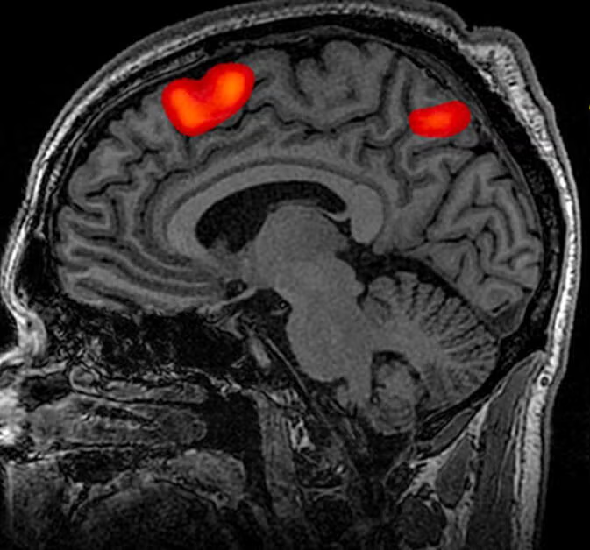
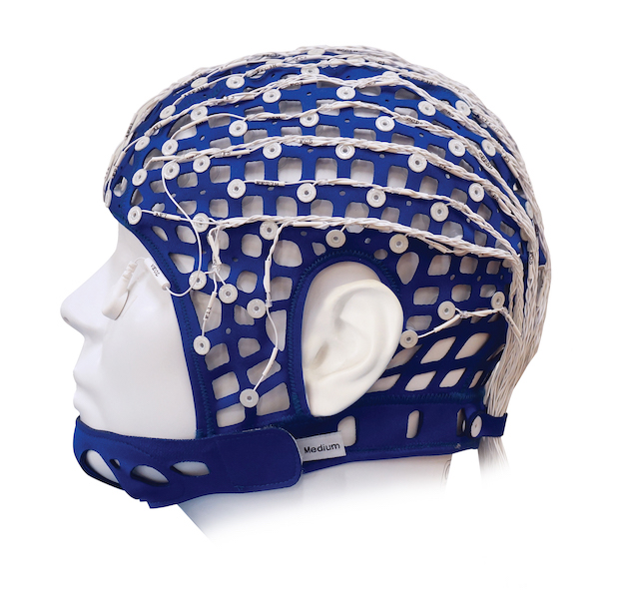
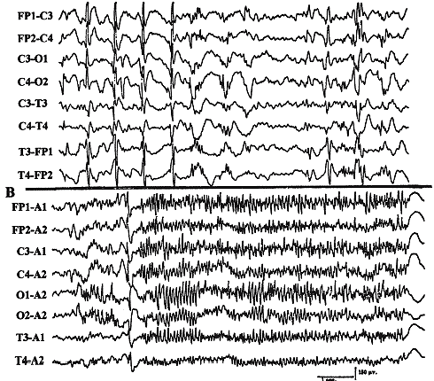
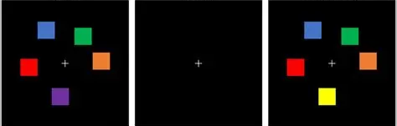
Measurements in psychology experiments
Mediciones en experimentos de psicología
Brain recordings
Registros cerebrales
Surveys
Encuestas
Behavioral Tasks
Tareas conductuales

Slide 47
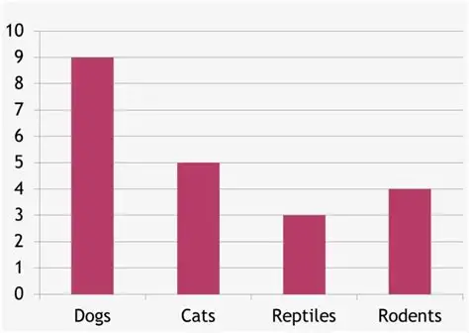
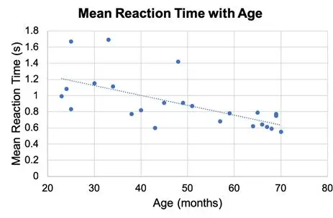
Once we have data, then what?
Una vez que tenemos los datos, ¿y luego qué?
Visualize with graphs
Visualizar con gráficos
Calculate averages
Calcular promedios
Check for statistical significance
Comprobar la significancia estadística
Detect outliers
Detectar valores atípicos
Make predictions based on trends
Hacer predicciones basadas en tendencias
Notes:
Outlier: A data point much higher or lower than the rest that doesn’t fit the pattern; important because it can affect averages, trends, and conclusions, and may reveal errors or unusual cases.

Slide 48
Correlation vs Causation
Correlation: Two variables change together, but one does not necessarily cause the other.
Causation: One variable directly affects the other.
* Just because two things happen together doesn’t mean one causes the other. Always check for other explanations or confounding factors.
Correlación: Dos variables cambian juntas, pero una no necesariamente causa a la otra.
Causalidad: Una variable afecta directamente a la otra.
* El hecho de que dos cosas ocurran juntas no significa que una cause a la otra. Siempre hay que revisar otras explicaciones o factores de confusión.
Notes:
This is important when interpreting data

Slide 49
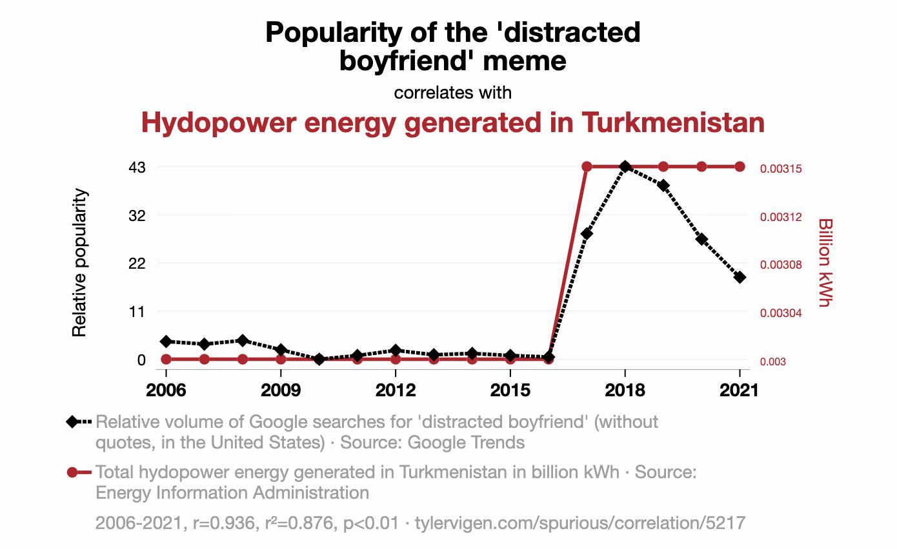
Correlation or Causation?
¿Correlación o causalidad?
Notes:
Go to the website and click random- it will continue to bring up random correlations.
Try to come up with a confounding variable that could account for the correlation.

Slide 50
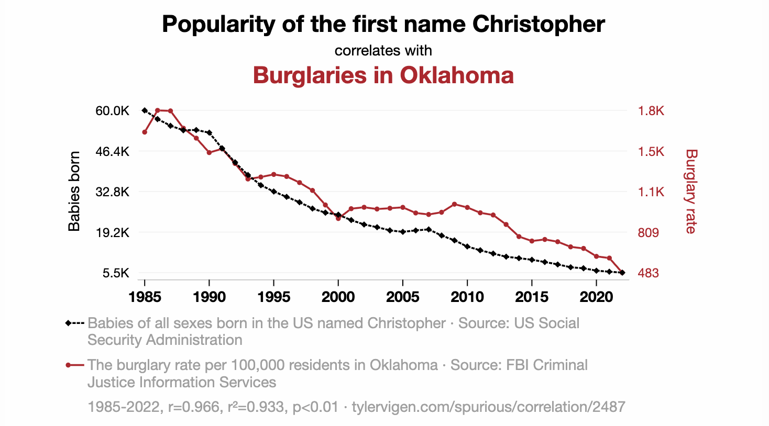
Correlation or Causation?
¿Correlación o causalidad?
Notes:
Go to the website and click random- it will continue to bring up random correlations.
Try to come up with a confounding variable that could account for the correlation.

Slide 51
Marshmallow Experiment
Experimento del malvavisco
Methods:
Researches gave children (ages 3-5) a choice between having one marshmallow right now or waiting 15 minutes and have two marshmallows.
The researchers would then leave the room and observe which children would eat the marshmallows .
They then followed up years later and looked at which kids were successful.
Métodos:
Los investigadores les dieron a niños de 3 a 5 años la opción de comer un malvavisco de inmediato o esperar 15 minutos para recibir dos malvaviscos.
Luego, los investigadores salían de la habitación y observaban cuáles niños comían el malvavisco.
Años después, hicieron un seguimiento de los participantes para evaluar cuáles de ellos habían tenido más éxito en la vida.

Slide 52
Marshmallow Experiment
Experimento del malvavisco
Results:
They found that children who waited often ended having higher academic success and less behavioral problems.
The experiment became a symbol for will power, self-control, and delayed gratification.
Confounding Variable
Researchers later found that waiting and life success were better explained by family income, home environment, and parental education.
Resultados:
Encontraron que los niños que esperaron tendían a tener un mayor éxito académico y menos problemas de comportamiento.
El experimento se convirtió en un símbolo de la fuerza de voluntad, el autocontrol y la gratificación retrasada.
Variable de confusión
Más tarde, los investigadores descubrieron que la relación entre esperar y el éxito en la vida se explicaba mejor por factores como los ingresos familiares, el ambiente del hogar y el nivel educativo de los padres.

Slide 53

Introduction to Memory

Slide 54
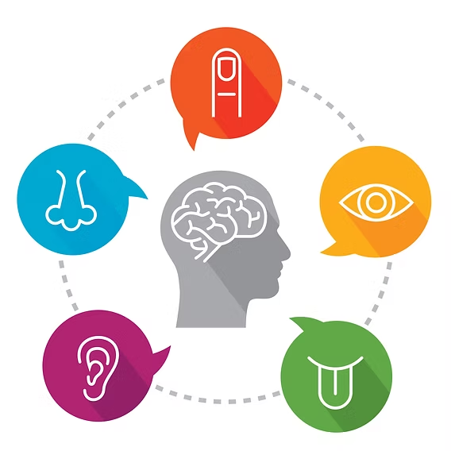
Types of Memory
Tipos de memoria
Sensory Memory: Holds incoming information from your senses for a very short time.
Memoria sensorial: Retiene la información que llega de tus sentidos por un tiempo muy breve.
Short-Term / Working Memory: Holds a small amount of information for a short time so you can use it right away.
Memoria a corto plazo / Memoria de trabajo: Retiene una pequeña cantidad de información por un tiempo breve para poder usarla de inmediato.
Notes:
Sensory example: Seeing a lightning flash before it disappears.
Short-term example: Remembering a phone number long enough to dial it.

Slide 55
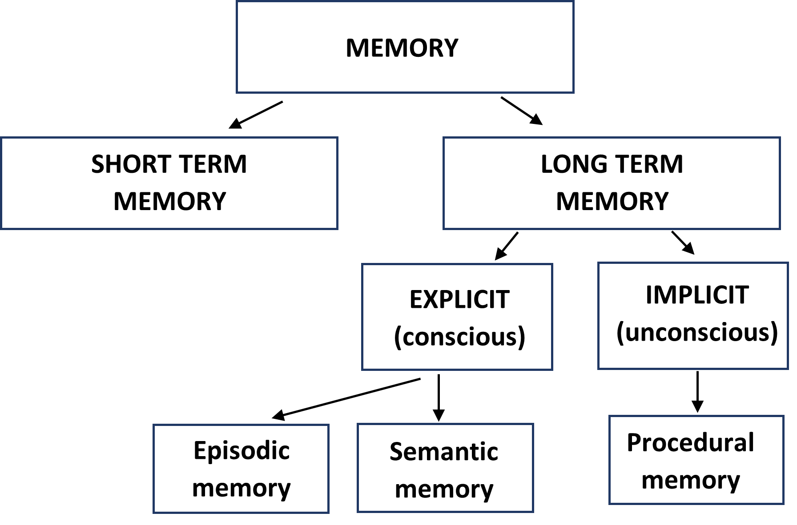
Types of Memory
Tipos de memoria
3. Long Term Memory:
Explicit: Memories you can consciously recall and describe.
Episodic: Personal experiences and events
Semantic: Facts and general knowledge
Implicit/Procedural: Memory that affects what you do or how you act without thinking.
3. Memoria a Largo Plazo:
Explícita: Recuerdos que puedes recordar y describir.
Episódica: Experiencias y eventos personales
Semántica: Hechos y conocimientos generales
Implícita/Procedimental: Memoria que influye en lo que haces o cómo actúas sin pensar.
Notes:
Episodic example: Your last birthday party
Semantic example: Knowing the capital of France is Paris
Implicit example: Riding a bike, brushing your teeth

Slide 56
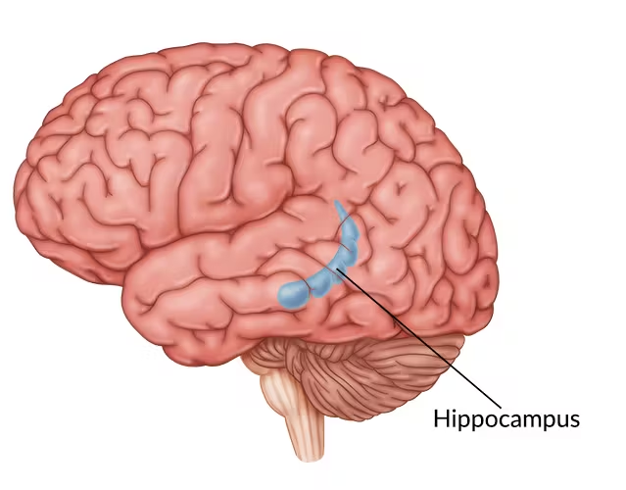
Stages of Memory
Etapas de la memoria
Encoding: The process of taking in information and converting it into a form the brain can store.
Codificación: El proceso de recibir información y convertirla en una forma que el cerebro pueda almacenar.
Storage: Maintaining the information over time in your memory system.
Almacenamiento: Mantener la información a lo largo del tiempo en tu sistema de memoria.
Retrieval: Accessing stored information when you need it.
Recuperación: Acceder a la información almacenada cuando la necesitas.
Notes:
Encoding example: Reading a friend’s phone number and mentally storing it.
Storage example: Remembering facts from a history class for months.
Retrieval example: Recalling the answer to a test question or your friend’s phone number.

Slide 57
Activity:
Actividad
We are going to show you a list of words for 20 seconds. After the time is up, write down as many words as you can remember.
Vamos a mostrarles una lista de palabras durante 20 segundos. Cuando termine el tiempo, escriban todas las palabras que puedan recordar.
Notes:
Pen and paper needed.
Clarify that the Spanish list will be below the English one.
Start a timer for 20 seconds so you know when to click off.

Slide 58
apple | spinach
banana | hammer
wrench | passport
suitcase | nurse
lawyer | drill
ticket | doctor
manzana | espinaca
banana | martillo
llave inglesa | pasaporte
maleta | enfermera
abogado | taladro
boleto | médico

Slide 59
Memory Recall
Recuperación de la memoria
How many words did you recall?
What strategies did you use to recall the words?
¿Cuántas palabras recuerdas?
¿Qué estrategias utilizaste para recordar las palabras?

Slide 60
Strategies for Encoding Memories
Estrategias para codificar recuerdos
Chunking: Grouping related items together to reduce the load on working memory.
Agrupamiento: Agrupar elementos relacionados para reducir la carga en la memoria de trabajo.
Visual Imagery: Creating mental pictures for items you want to remember.
Imágenes visuales: Crear imágenes mentales de los elementos que quieres recordar.
Self-Referencing: Relating information to yourself personally.
Auto-referencia: Relacionar la información contigo mismo de manera personal.
Mnemonics: Using acronyms, rhymes, or phrases to link items together.
Mnemotecnia: Usar acrónimos, rimas o frases para enlazar elementos.
Notes:
Chunking: Food, tools, travel, occupations
Visual imagery: Picturing a doctor with a suitcase eating a banana
Self-referencing: apple, banana, spinach → “These are all healthy foods I eat for breakfast.”
Mnemonics: “Passport, suitcase, ticket in place, ready for the race.”

Slide 61
Amnesia
Amnesia: loss of memories, either partial or complete, typically caused by brain injury, disease, or trauma.
Retrograde Amnesia: Loss of past memories prior to the injury/event
Anterograde Amnesia: Inability to form new long-term memories after the injury/event
Amnesia: pérdida de recuerdos, ya sea parcial o total, normalmente causada por una lesión cerebral, una enfermedad o un trauma.
Amnesia retrógrada: pérdida de recuerdos anteriores a la lesión o evento.
Amnesia anterógrada: incapacidad para formar nuevos recuerdos a largo plazo después de la lesión o el evento.
Notes:
Retrograde example: Forgetting high school friends after a car accident
Anterograde example: Cannot remember meeting someone 5 minutes ago

Slide 62
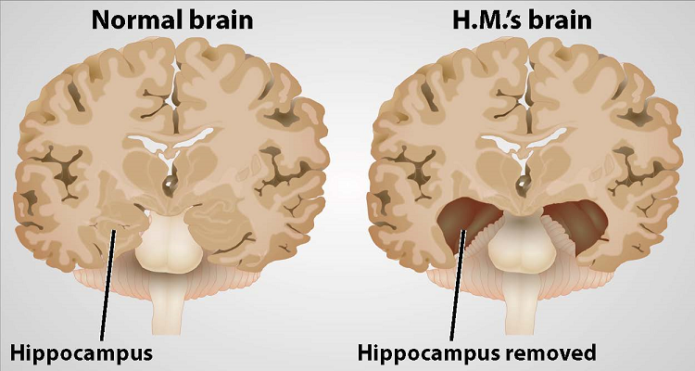
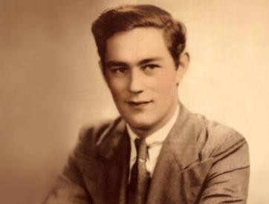
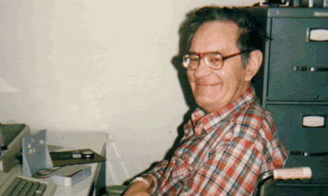
Henry Molaison’s (H.M.) Brian
H.M. was a patient with severe epilepsy
Doctors removed his hippocampus
He could no longer form new long-term memories
Which type of amnesia did he have?
Paciente con epilepsia severa
Los médicos le extirparon el hipocampo
Ya no podía formar nuevos recuerdos a largo plazo
¿Qué tipo de amnesia tenía?
Notes:
He had anterograde amnesia.

Slide 63
Clive Wearing
Music conductor, highly skilled in piano.
In 1985, he contracted a virus that attacked his brain, causing severe damage to the hippocampus and surrounding areas.
Has both anterograde and retrograde amnesia
Cannot recall old memories or form new ones
Procedural memory remained intact: he could still play the piano and conduct music perfectly.
Director de orquesta, altamente capacitado en piano.
En 1985, contrajo un virus que atacó su cerebro. El virus causó daños graves en el hipocampo y las áreas circundantes.
Presenta amnesia anterógrada y retrógrada. No puede recordar recuerdos antiguos ni formar nuevos.
Su memoria procedimental se mantuvo intacta: todavía podía tocar el piano y dirigir música perfectamente.
Notes:
Both of these cases taught us the importance of the hippocampus on forming/encoding and recalling memories.

Slide 64
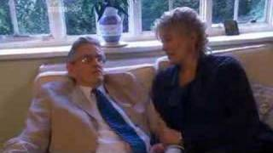
Clive Wearing

